Slide 1




MBC 638:
Data Analysis & Decision Making
Anna Chernobai
Lecture 10:
Central Limit Theorem and sampling distributions (Chapter 7)
Notes:
Chernobai

Slide 2
Today…
We are frequently interested in estimating the population mean μ.
Typically, to do so, we estimate the mean of some chosen sample, i.e., x, and then make inference about the population mean based on this point estimate.
How accurate is our estimation of the population mean based on the sample mean? Is the sample mean a good predictor of the population mean? What is the estimation error (= sampling error)?
MBC638-Chernobai
Lecture 10

Slide 3
Today: CLT and sampling distributions
Law of Large Numbers
Central Limit Theorem
Sampling distribution - examples
MBC638-Chernobai
Lecture 10

Slide 4
Today: CLT and sampling distributions
Law of Large Numbers
Central Limit Theorem
Sampling distribution - examples
MBC638-Chernobai
Lecture 10

Slide 5
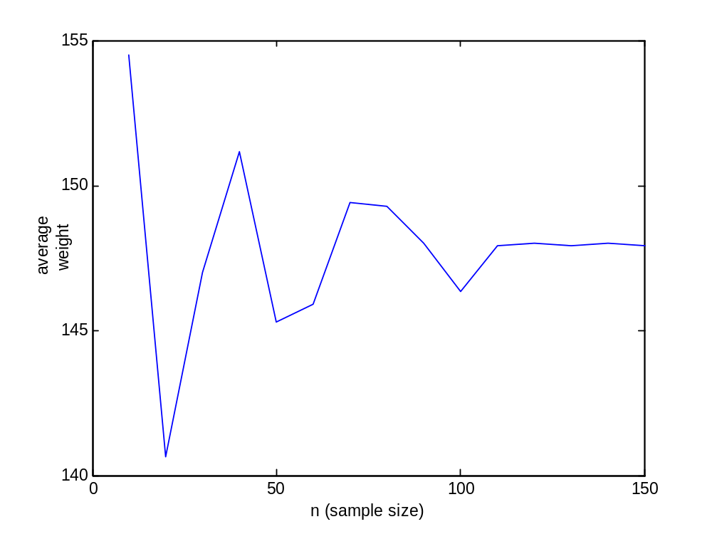
1. Law of Large Numbers
Law of Large Numbers (LLN)
As sample size n increases, x approaches μ .
x
μ
MBC638-Chernobai
Lecture 10

Slide 6
1. Law of Large Numbers
Law of Large Numbers (LLN)
As sample size n increases, x approaches μ .
x
What we observe:
x approaches μ as n increases (LLN)
x has a distribution
x is more volatile for small n
μ
MBC638-Chernobai
Lecture 10

Slide 7
Today: CLT and sampling distributions
Law of Large Numbers
Central Limit Theorem
Sampling distributions - examples
MBC638-Chernobai
Lecture 10

Slide 8
2. Central Limit Theorem
We just saw that sample mean is a random variable and has a distribution.
What can we tell about this distribution of the sample mean?
Central Limit Theorem:
When sample size n is large, then:
Sample mean (X) is approximately Normally distributed.
Notice that I did not say whether the distribution of the population (X) from which the sample was taken was Normal. In fact, it does not matter!
MBC638-Chernobai
Lecture 10

Slide 9
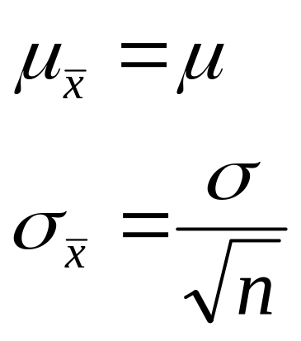
2. Central Limit Theorem
If a random sample of size n is drawn from any distribution that has mean μ and standard deviation σ, then, if n is large:
sample mean x is approximately Normally distributed with
MBC638-Chernobai
Lecture 10

Slide 10
2. Central Limit Theorem
How large is large?
n is considered large when n ≥ 30
MBC638-Chernobai
Lecture 10

Slide 11
Today: CLT and sampling distributions
Law of Large Numbers
Central Limit Theorem
Sampling distribution - examples
MBC638-Chernobai
Lecture 10

Slide 12

3. Sampling distributions - examples
Example
Application: Insurance
The mean annual cost of automobile insurance is $939 (CNBC, Feb.23 2006). The standard deviation is $245 per policy.
What is the probability that a sample of 50 policies will have mean cost within $25 of the population mean?
A certain sample of 50 policies showed that the mean cost is $990. Would you say it’s a biased sample?
Why do you think insurance companies benefit from insuring a very large pool of people as opposed to a very small pool? Hint: Think about the standard deviation of a sample mean.
Lecture 10

Slide 13
3. Sampling distributions - examples
Application: Insurance
The standard deviation of annual cost of automobile insurance is $245 per policy.
What is the probability that a sample of 50 policies will have mean cost within $25 of the population mean?
You can solve this problem even if you don’t know the mean value!
Example
MBC638-Chernobai
Lecture 10

Slide 14

3. Sampling distributions - examples
Application: Insurance
The monthly premium that you pay for your health insurance reflects reflect the average cost that the insurer will incur in case you get sick and require medical attention.
Insurance companies often determine the premiums of its policyholders as some high percentile (e.g., 99%) of the average cost distribution of the insureds’ pool. By doing so they make sure that there is only 1% chance that their average payout would exceed your average medical costs.
Explain why, the more there are people in the insureds’ pool, the lower your monthly premium will be. In other words, explain why you would benefit from purchasing insurance from a large insurance company.
Example
MBC638-Chernobai
Lecture 10

Slide 15
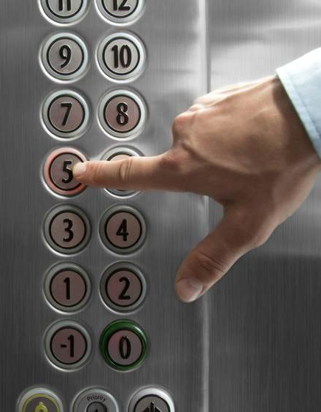
3. Sampling distributions - examples
Example
Suppose that a person’s weight has a mean of 170 pounds and a standard deviation of 55 pounds.
An elevator is designed to carry no more than 4,000 pounds. Manufacturers must design elevators in such a way that they can handle a necessary weight. Help the manufacturers to figure out the following.
Can they specify the maximum number of persons allowed in this elevator as 35? If not, then what would be a reasonable number of persons that they should specify?
MBC638-Chernobai
Lecture 10

Slide 16
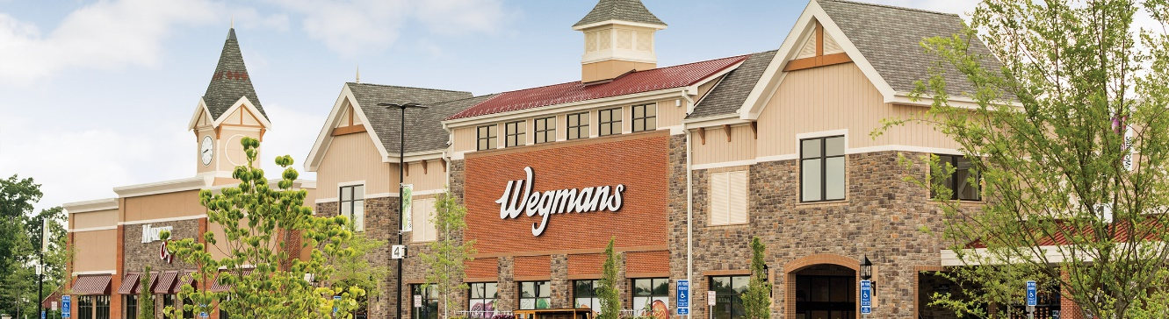
3. Sampling distributions - examples
Example
Wegman’s receipts show that customer purchase amounts have a right-skewed distribution with a mean of $49 and a standard deviation of $21. Suppose on a particular day Wegman’s had 502 customers.
Estimate the probability that the store’s revenues are at least $20,000.
In a typical day the store serves 502 customers, then how much does the store take in on the worst 5% of such days?
MBC638-Chernobai
Lecture 10

Slide 17

Today: CLT and sampling distributions
Law of Large Numbers
Central Limit Theorem
Sampling distributions – examples
What’s next? Confidence intervals.
MBC638-Chernobai
Lecture 10

